Slide 1
Cse 3104 Database LAB

Slide 2
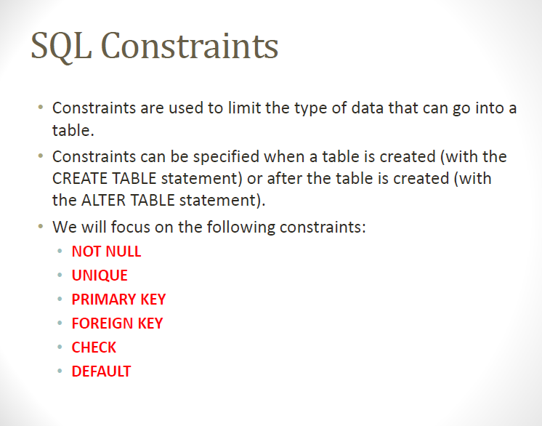

Slide 3
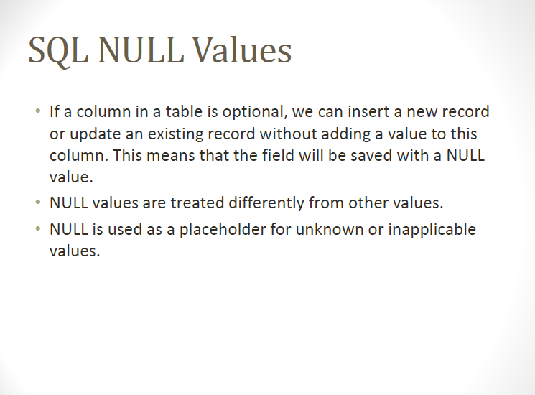

Slide 4
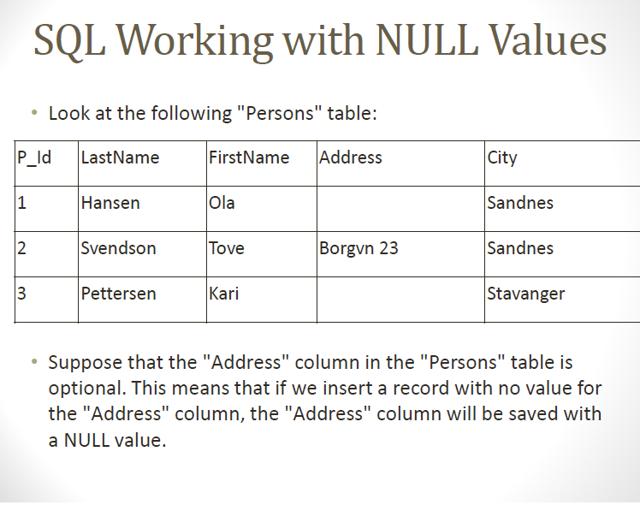

Slide 5
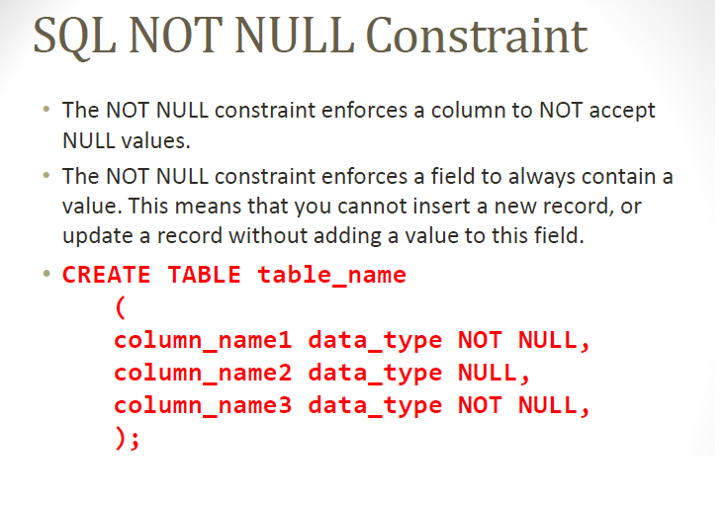

Slide 6
The following SQL enforces the "P_Id" column and the "LastName" column to not accept NULL values:
CREATE TABLE Persons
(
P_Id int NOT NULL,
LastName varchar(255) NOT NULL,
FirstName varchar(255),
Address varchar(255),
City varchar(255)
)

Slide 7
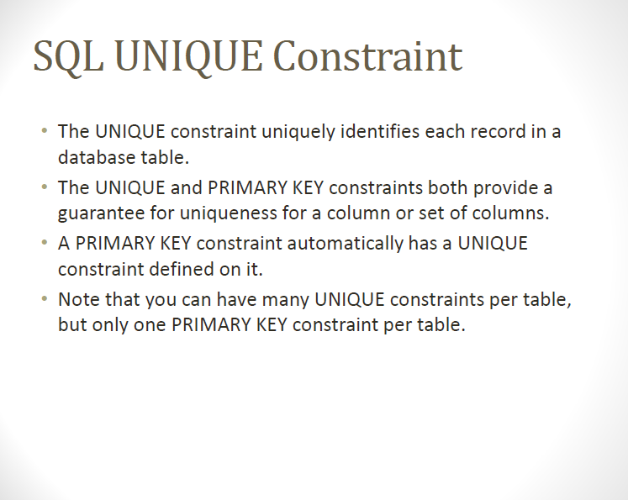

Slide 8
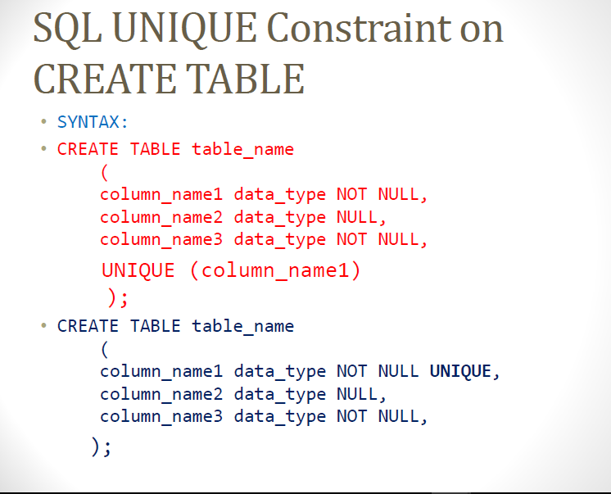

Slide 9
CREATE TABLE Persons
(
P_Id int NOT NULL UNIQUE,
LastName varchar(255) NOT NULL,
FirstName varchar(255),
Address varchar(255),
City varchar(255)
)

Slide 10


Slide 11
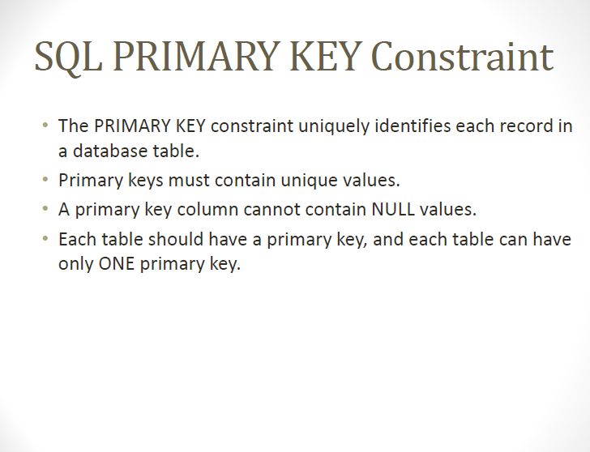

Slide 12
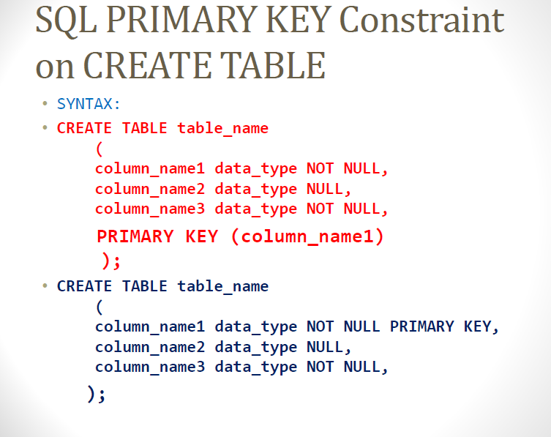

Slide 13
CREATE TABLE Persons ( P_Id int NOT NULL PRIMARY KEY, LastName varchar(255) NOT NULL, FirstName varchar(255), Address varchar(255), City varchar(255) )

Slide 14
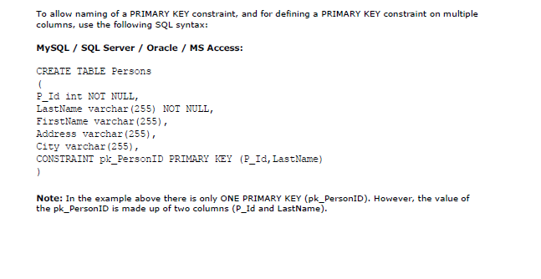

Slide 15
CREATE TABLE Persons ( P_Id int NOT NULL, LastName varchar(255) NOT NULL, FirstName varchar(255), Address varchar(255), City varchar(255), CONSTRAINT pk_PersonID PRIMARY KEY(P_Id,LastName) )

Slide 16
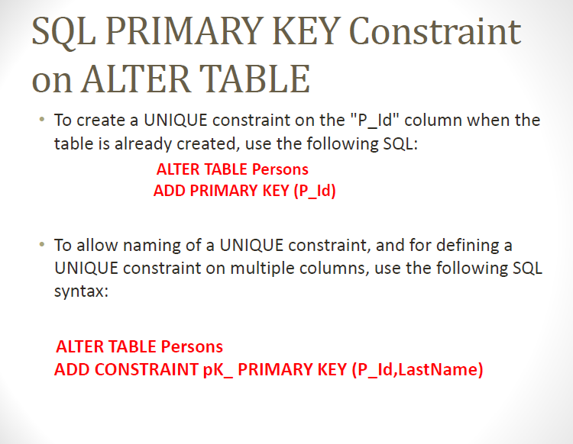

Slide 17
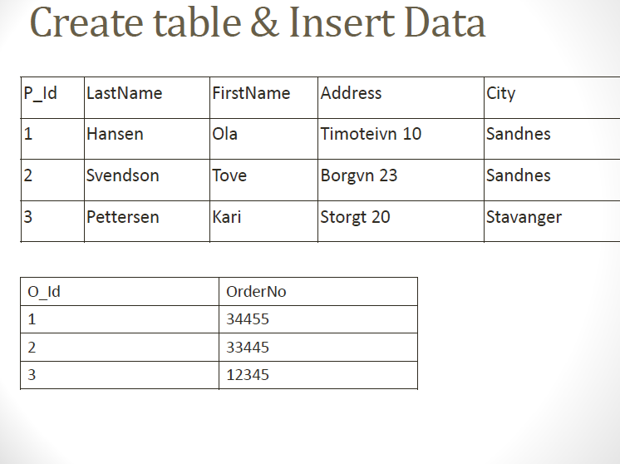

Slide 18
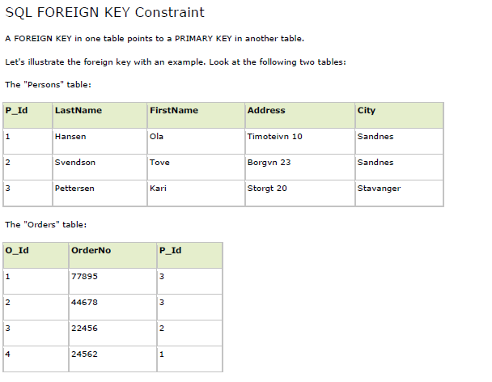

Slide 19
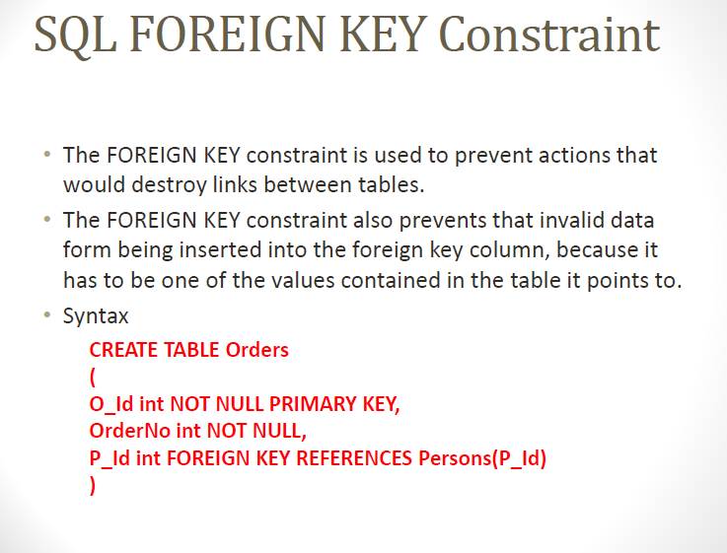

Slide 20
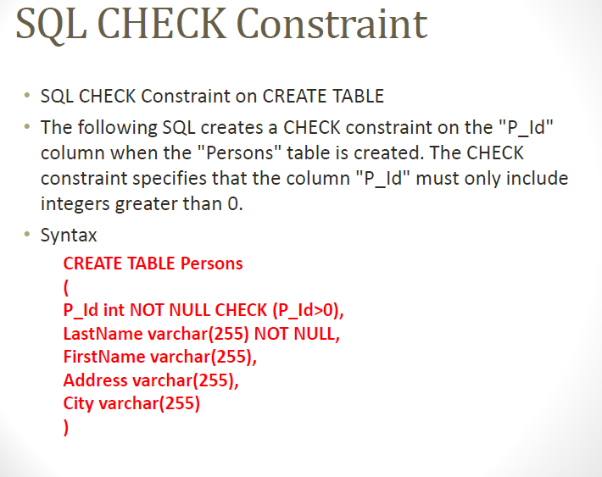

Slide 21


Slide 22
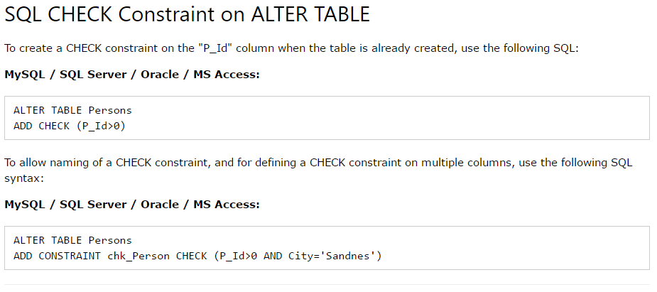

Slide 23
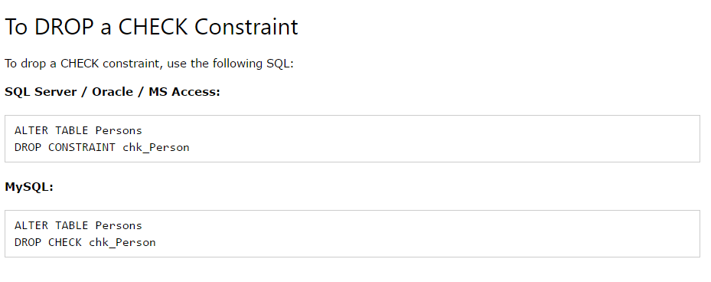

Slide 24
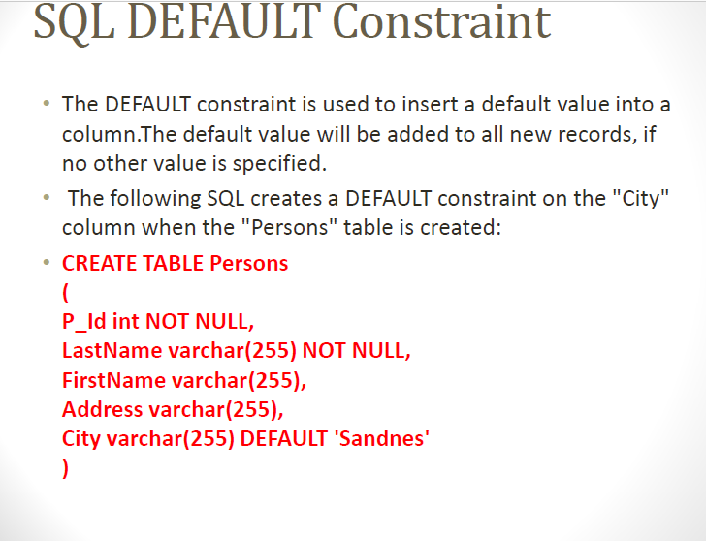

Slide 25
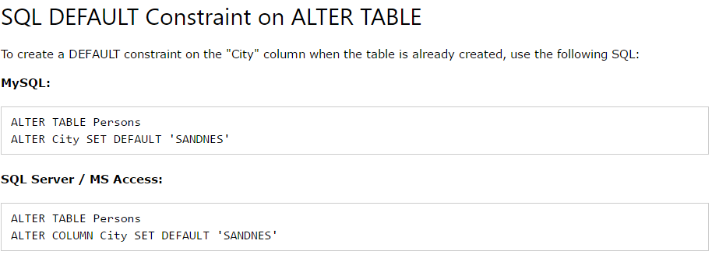

Slide 26

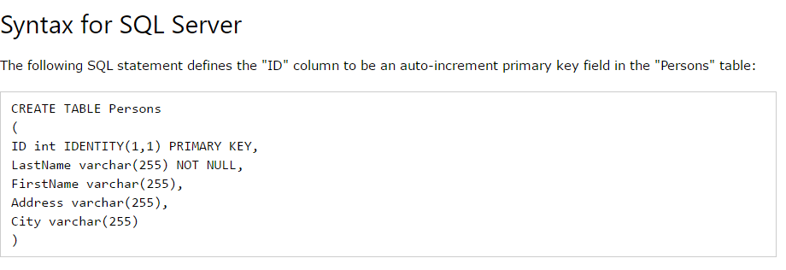

Slide 27
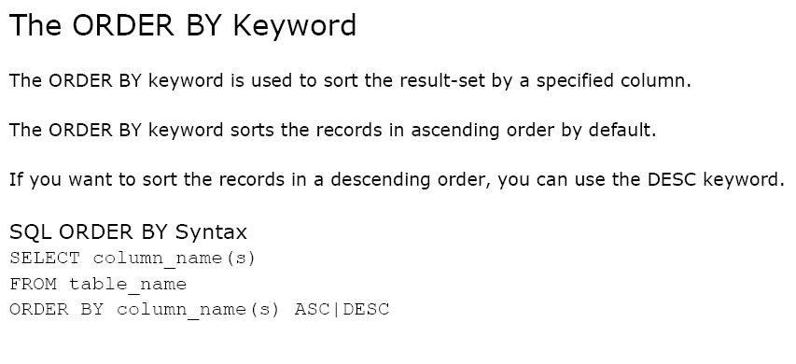

Slide 28
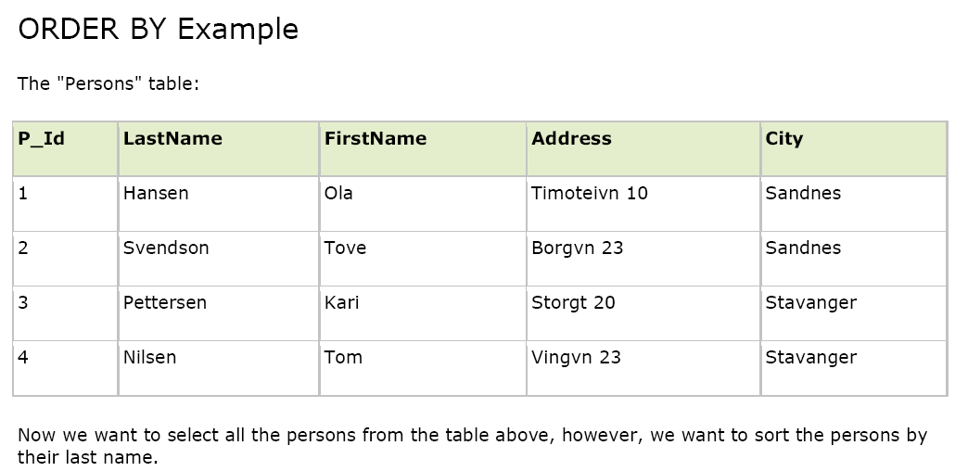

Slide 29
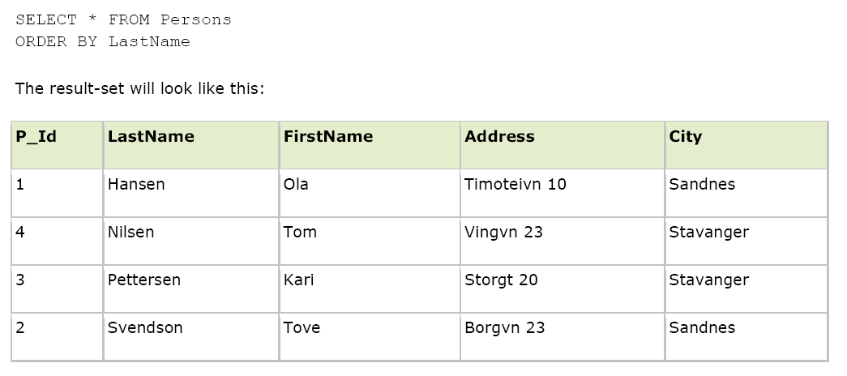

Slide 30

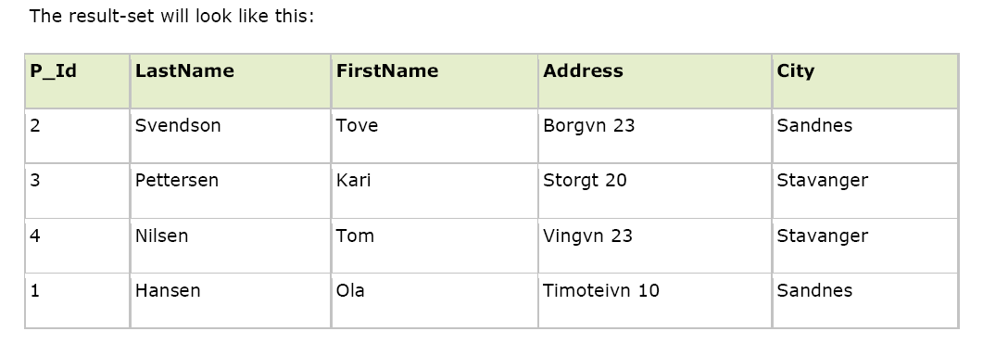

Slide 31
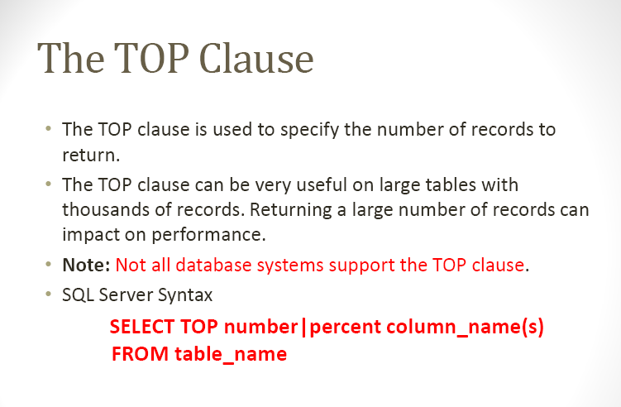

Slide 32
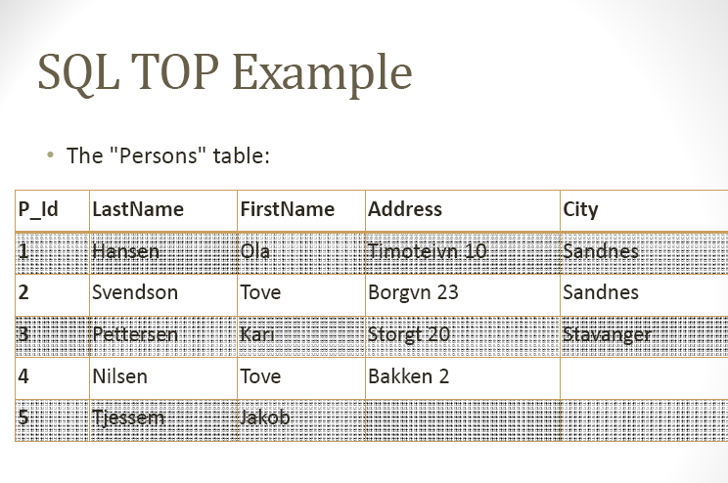

Slide 33
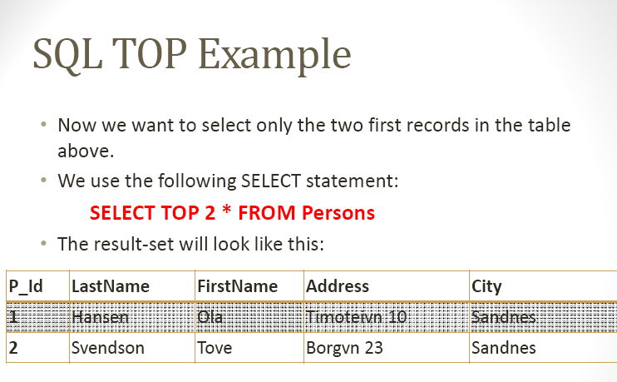

Slide 34
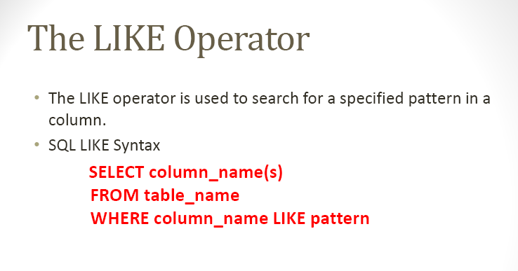

Slide 35
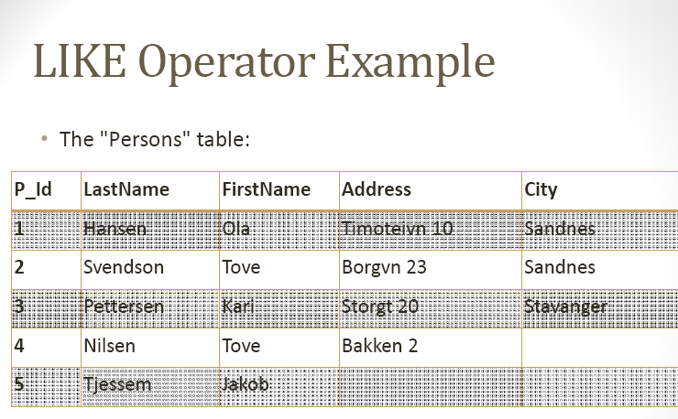

Slide 36
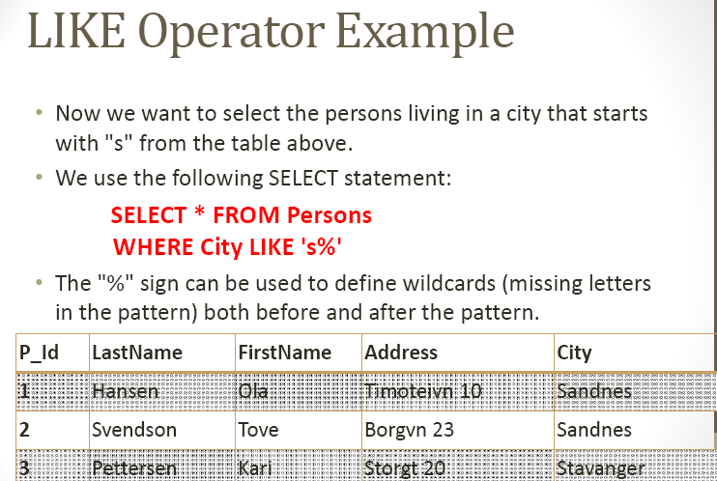

Slide 37
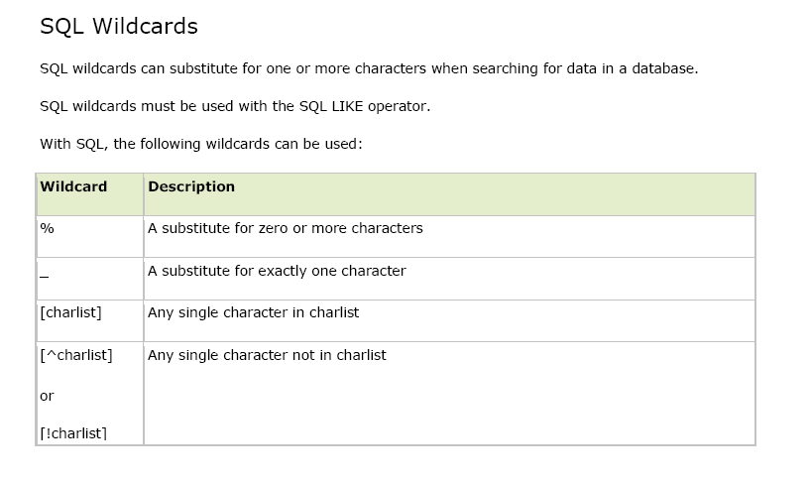

Slide 38
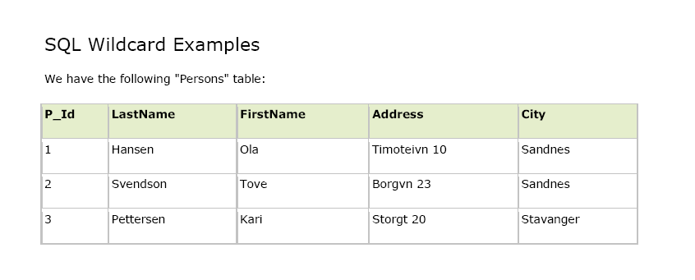

Slide 39
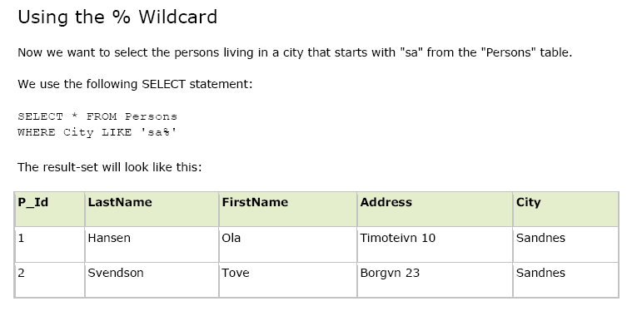

Slide 40
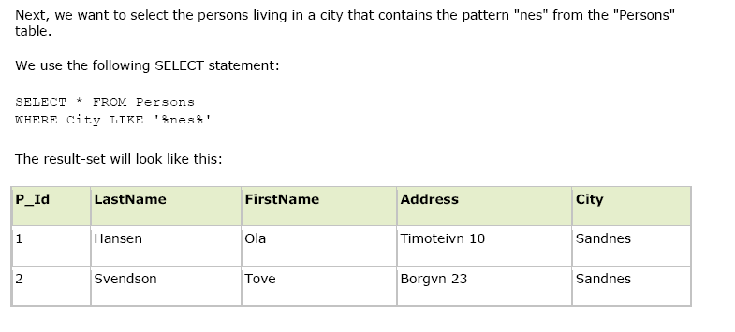

Slide 41
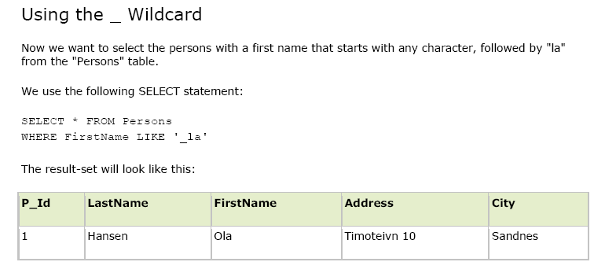

Slide 42
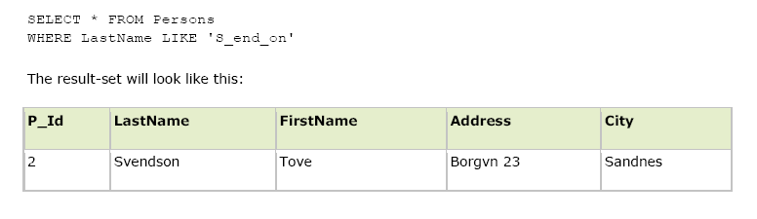

Slide 43
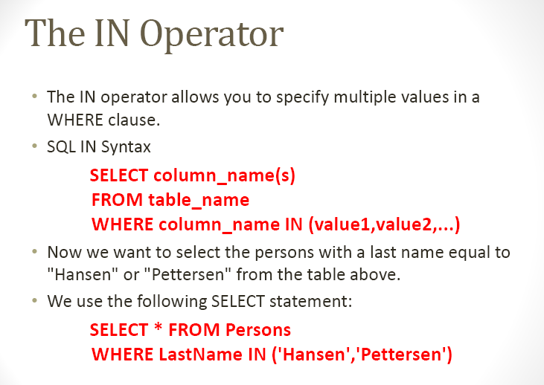

Slide 44
